Slide 1
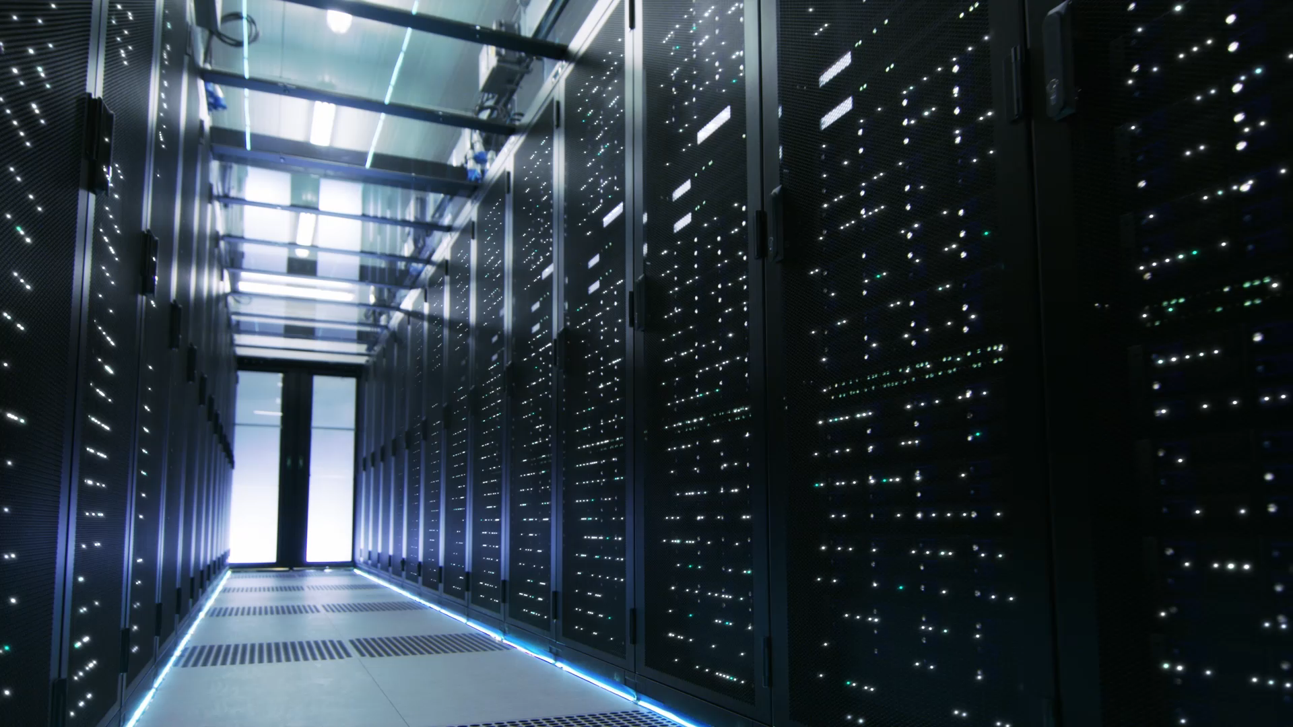
Introduction To Cloud Computing
Dr. Zainab Hassan Ali
Lecturer at the Department of Embedded Network and Technology, Faculty of Artificial Intelligence, Kafrelsheikh University
Email: zainabhassan@ai.kfs.edu.eg

Slide 2
This Course Contains 7 main parts as follows:
1- Introduction to cloud computing.
2- Introduction to Distributed System.
3- Networking Support.
4- Virtualization Technology.
5- Migration Technology.
6- MapReduce.
7- Yarn.

Slide 3
Course Overview:
This course is undergraduate-level introduction to Cloud Computing System and the application based on the context of cloud.
This module aims to teach students the fundamentals of Cloud Computing covering topics such as virtualization, MapReduce, cloud storage and popular cloud applications including batch and data stream processing. Emphasis is given on the different backend technologies to build and run efficient clouds and the way clouds are used by applications to realise computing on demand. The course will include practical tutorials on different cloud infrastructure technologies.

Slide 4
Notes
Lecture attendance is very important. You lose ½ degree for each lecture you miss.
Late submission of the tasks will be marked with deduction of %10 per day.
The assignments, and of course the quizzes, and exams need to be done individually
Students have to attend Exams or lecture on time – No Excuse are accepted.

Slide 5
In This Chapter
Why Cloud computing?
What’s the Cloud Computing?
Early models of Cloud Computing.
Delivery models and services.
Cloud Challenges.
Distributed Systems.

Slide 6
PART 1

Slide 7
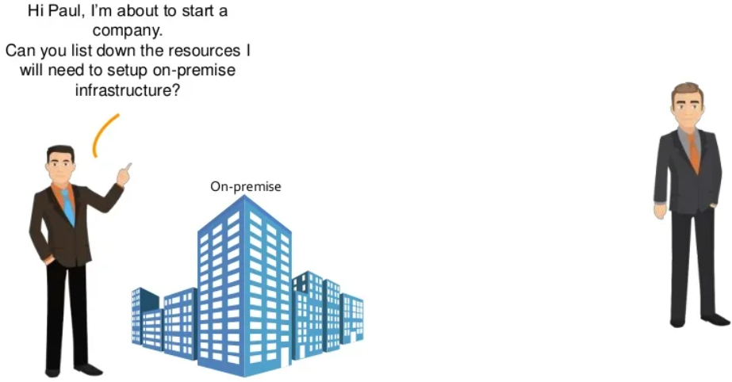
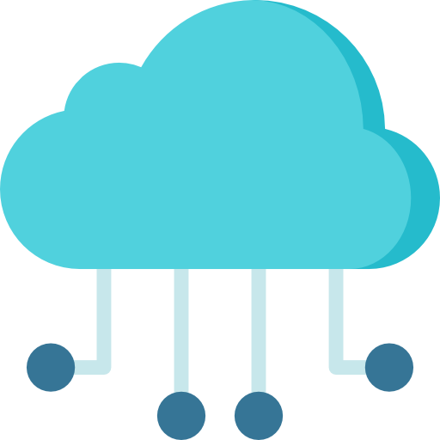
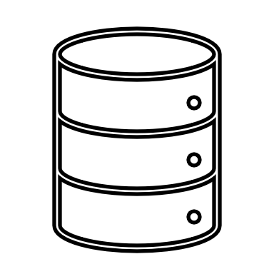

Why Cloud Computing?
Why not setup things on the cloud?
Cloud

Slide 8
What’s the Cloud Computing?
According to National Institute of Standards and Technology's (NIST), the Cloud Computing can be defined as:
"Cloud Computing is a model for enabling ubiquitous, convenient, on-demand network access to a shared pool of configurable computing resources (e.g., networks, servers, storage, applications and services) that can be rapidly provisioned and released with minimal management effort or service provider interaction."

Slide 9

What’s the Cloud Computing? Cont.
The NIST definition lists five essential characteristics of cloud computing:
The NIST definition lists three delivered models:
The NIST definition lists four deployment models:
On-demand self-service.
Broad network access.
Resource pooling.
Rapid elasticity or expansion.
Measured service.
Software-as-a-Service.
Platform-as-a-Service.
Infrastructure-as-a-Service.
Public.
Community.
Private.
Hybrid.
Describe the service nature that is delivered to the end user
Categorize the delivered services.

Slide 10
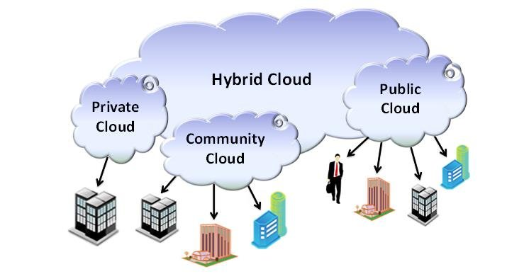
What’s the Cloud Computing? Cont.
Deployment Models in Cloud Computing:

Slide 11
Cloud Computing: Overview
Cloud Computing is a relatively new business model in the computing world.
Cloud is less expensive in general when measured against like items.
Cloud Computing is 100 percent variable costs.
Cloud Computing supports on-demand model.
Services are customized as user need.
By Cloud model, the computing scalability is provided when it needed without high IT overhead.
Cloud provides a set of computing services that can be installed easily such as “Cloud Desktop”. (http://www.awitty.com/)

Slide 12
Cloud Computing: Overview-Cont.
Cloud is commercial available of individual computing services delivered remotely.
The services include, but are not limited to:
Desktop
Disk storage.
Database.
Analysing.
Networking.
Processing.
What’s the difference between Disk Storage and Database?

Slide 13
Early Models of Cloud Computing
The last decades have reinforced the idea that information processing can be done more efficiently centrally, on large farms of computing and storage systems accessible via the Internet. When computing resources in distant data centers are used rather than local computing systems, we talk about Network-Centric Computing and Network-Centric Content.
Advancements in networking and other areas are responsible for the acceptance of the two new computing models and led to the grid computing movement in the early 1990s and, since 2005, to utility computing and cloud computing.

Slide 14
Early Models of Cloud Computing-Cont.
*What is the difference between Grid Computing and Cloud Computing?
Grid Computing
Utility Computing
Both are network-based computing technologies that involve resource pooling, but cloud computing eliminates the complexity of buying hardware and software for building applications by allocating resources that are placed over multiple servers in clusters.
Similarity:
Difference:
Grid Computing allows users to access resources directly.
User doesn’t access the resources directly, rather it makes a huge resource pool through shared resources.

Slide 15
Early Models of Cloud Computing-Cont.
*What is the difference between Grid Computing and Cloud Computing?
Grid Computing
Utility Computing
Overview:
Initiated by the National Labs in the early 1990s; targeted primarily at scientific computing
Initiated in 2005-2006 by IT companies and targeted at enterprise computing.
Definition:
The collection of physical computer resources from multiple locations to reach a common goal. The grid can be thought of as a distributed system with non-interactive workloads that involve a large number of files
A service provisioning model in which a service provider makes computing resources and infrastructure management available to the customer as needed.

Slide 16
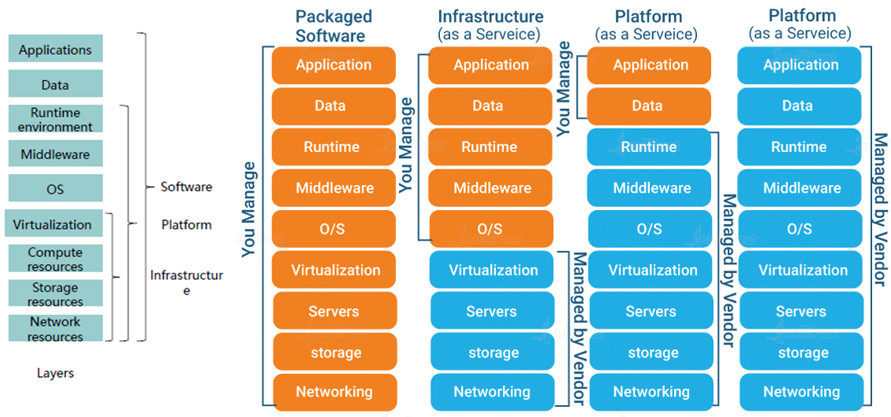
Cloud Delivered Models

Slide 17
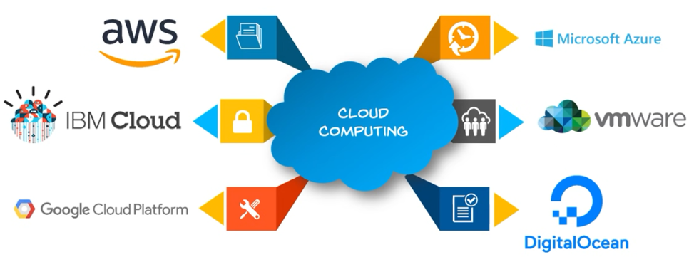
Recent Cloud Providers:

Slide 18
Cloud Computing Challenges
Availability of service: what happens when the service provider cannot deliver?
Data confidentiality and auditability, a serious problem.
Diversity of services, data organization, user interfaces available at different service providers limit user mobility; once a customer is hooked to one provider it is hard to move to another.
Data transfer bottleneck; many applications are data-intensive.

Slide 19
Cloud Computing Challenges-Cont.
V. Performance unpredictability, one of the consequences of resource sharing.
How to use resource virtualization and performance isolation for QoS guarantees?
How to support elasticity, the ability to scale up and down quickly?
VI. Resource management: It is a big challenge to manage different workloads running on large data centers. Are self-organization and self-management the solution?

Slide 20
Distributed System
Collection of autonomous computers, connected through a network and distribution software (often) called middleware which enables computers to coordinate their activities and to share system resources for a common goal.
Cloud computing builds upon the distributed system architecture.
See the Next Lecture

Slide 21
References
[1] https://www.cl.cam.ac.uk/teaching/1819/CloudComp/ accessed Feb.2022
[2] Dan C. Marinescu, Cloud Computing Theory and Practice. Elsevier, 2013

Slide 22
Report 1
What is the Cloud Computing?
What is the difference between Cloud Computing and Cloud Services?
List cloud delivered models and state the example for each one
What is the major difference between cloud computing and grid computing?

Slide 23
Report 2
Compare between recent cloud providers

Slide 24
Activity 1
Read and summarize the following paper:
Asmaa H. Rabie, Shereen H. Ali, Hesham A. Ali, Ahmed I. Saleh, “A fog based load forecasting strategy for smart grids using big electrical data”. Cluster Computing (2019) 22:241–270.

Slide 25
Thank You

